Slide 1





JoJo Technology -
Iteration 2
Group Member: Amy Nguyen, Zhuoyue Sun, Jiahao Zhang, Xiaocheng Kang

Slide 2
Member Introduction
Project Manager: Amy Nguyen
Technical Manager: Zhuoyue Sun
Developers: Jiahao Zhang and Xiaocheng Kang

Slide 3



1.
Burn down Chart
And Task Board
Presenter: Zhuoyue Sun

Slide 4
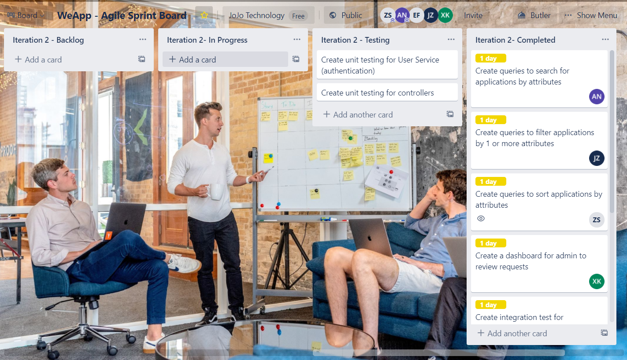
Trello Task Board

Slide 5
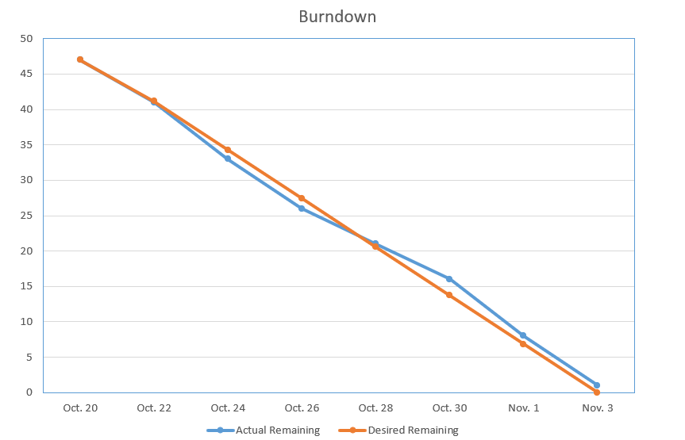
Burndown Chart
Days worked: 14 days
Total hours estimated for this iteration 47 hours
Finished Iteration 1 first
Beyond
Behind schedule
Speed up
Ave 3.29h per day (0.82h per day/person)

Slide 6








2. Working
Web App & progress
Presenter: Zhuoyue Sun & Xiaocheng Kang

Slide 7
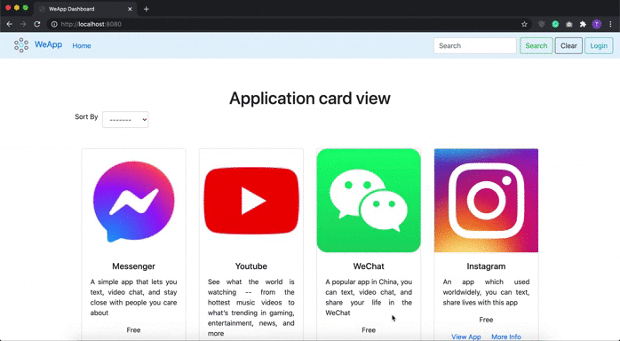
Homepage of WeApp - all users (including unregistered user can view this screen to see the list of applications)

Slide 8

Sort by name (from A-Z) functionality - we will be implementing sort by category, price, and maybe rating in the future. Notice how the URL append ?sortBy=name

Slide 9
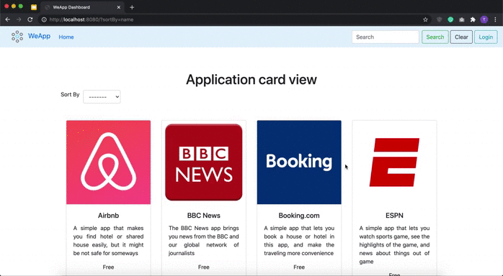
Search by name functionality. For example, if user enter ‘youtube’ in the search bar and click on the Search button, only the Youtube app is shown. Notice how the URL append ?keyword=youtube?

Slide 10
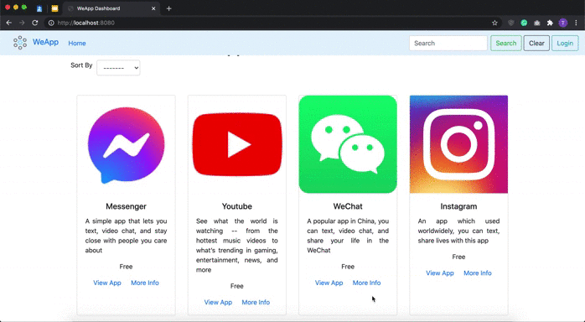
When clicked on the ‘View App’ link on each app, it directs the users to view the app on the app store to download the app.

Slide 11

When clicked on the ‘More Info’ link on each app, it directs the users to a page that shows more information about the particular app (name, company, description), and a slideshow of screenshots

Slide 12
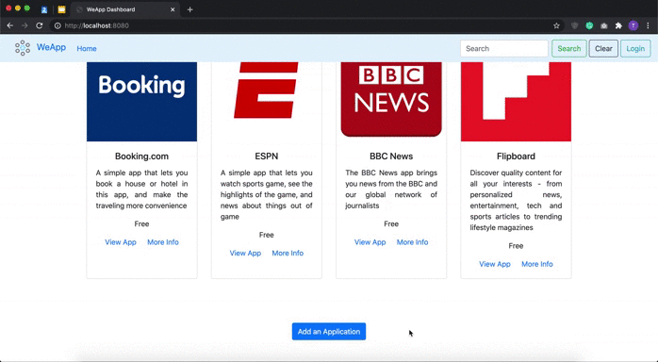
The Add an application request is only available to register users - so when an unregistered user click on the button, the website asks us to login first

Slide 13
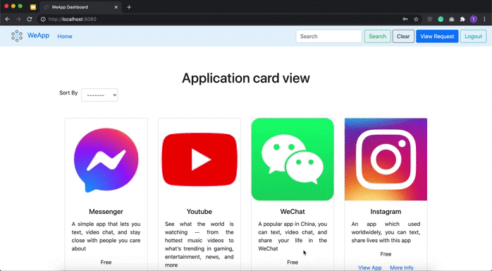
The view request button is only visible to admin-level users. When clicked on the button, it directs to the dashboard page where admins can edit the app’s information

Slide 14
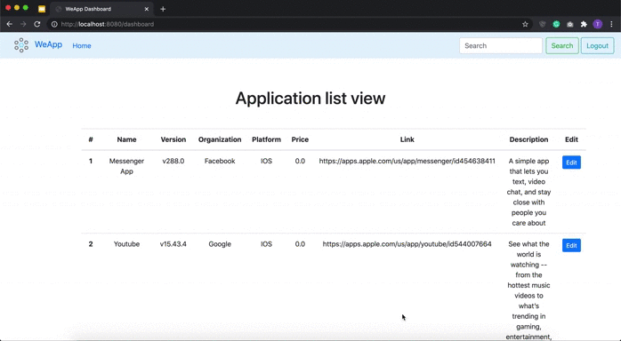
When a user clicked on the Logout button, the website will redirect the user back to the login page and show a message to indicate user has successfully logged out

Slide 15
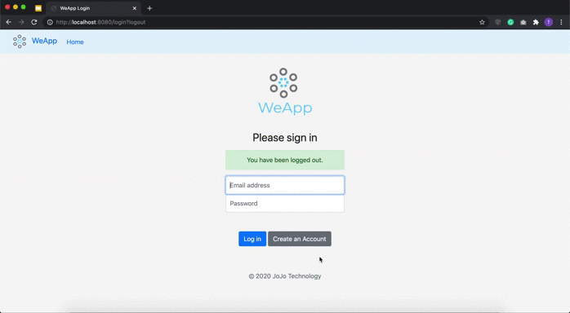
For example, if a user without admin-level access logged into the website, they would not see the view request button

Slide 16
3. Testing
Deliverables
Presenter: Amy Nguyen

Slide 17
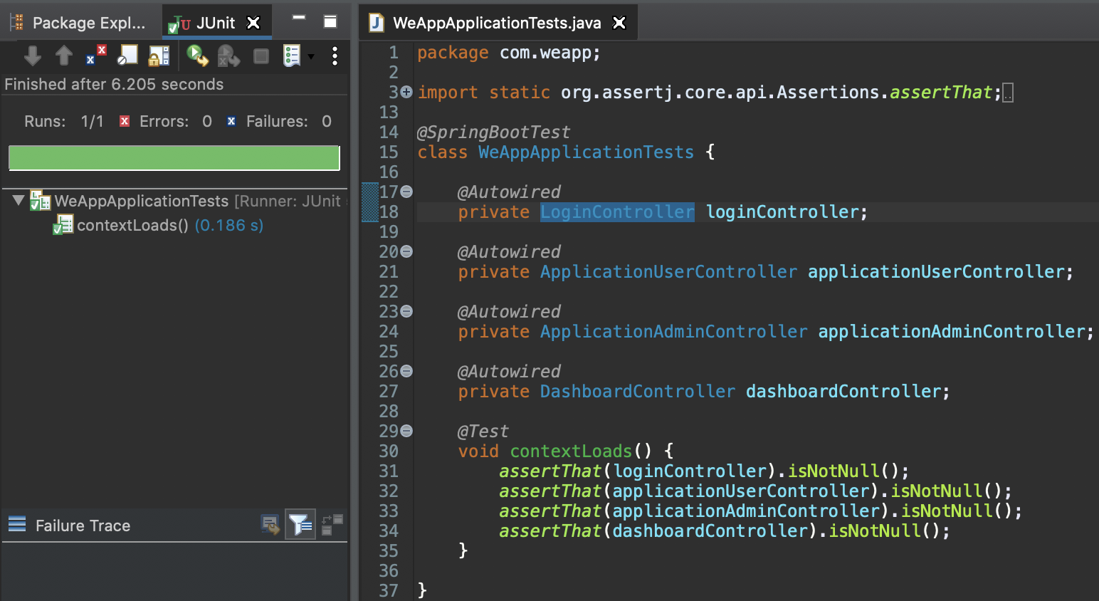
Test the Application
If the application is running, we can test it by going to localhost:8080. But to give us more confidence, we automate the testing. This is a simple sanity check test that will fail if the application context cannot start or the context is not creating controllers.

Slide 18
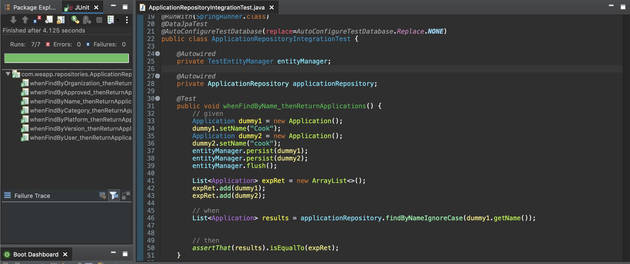
Unit Testing for Application Repo
This is the unit test for our Application Repo class.
whenFindByName_thenReturnApplications
whenFindByOrganization_thenReturnApplications
whenFindByVersion_thenReturnApplications
whenFindByApproved_thenReturnApplications
whenFindByCategory_thenReturnApplications
whenFindByPlatform_thenReturnApplications
whenFindByUser_thenReturnApplications

Slide 19
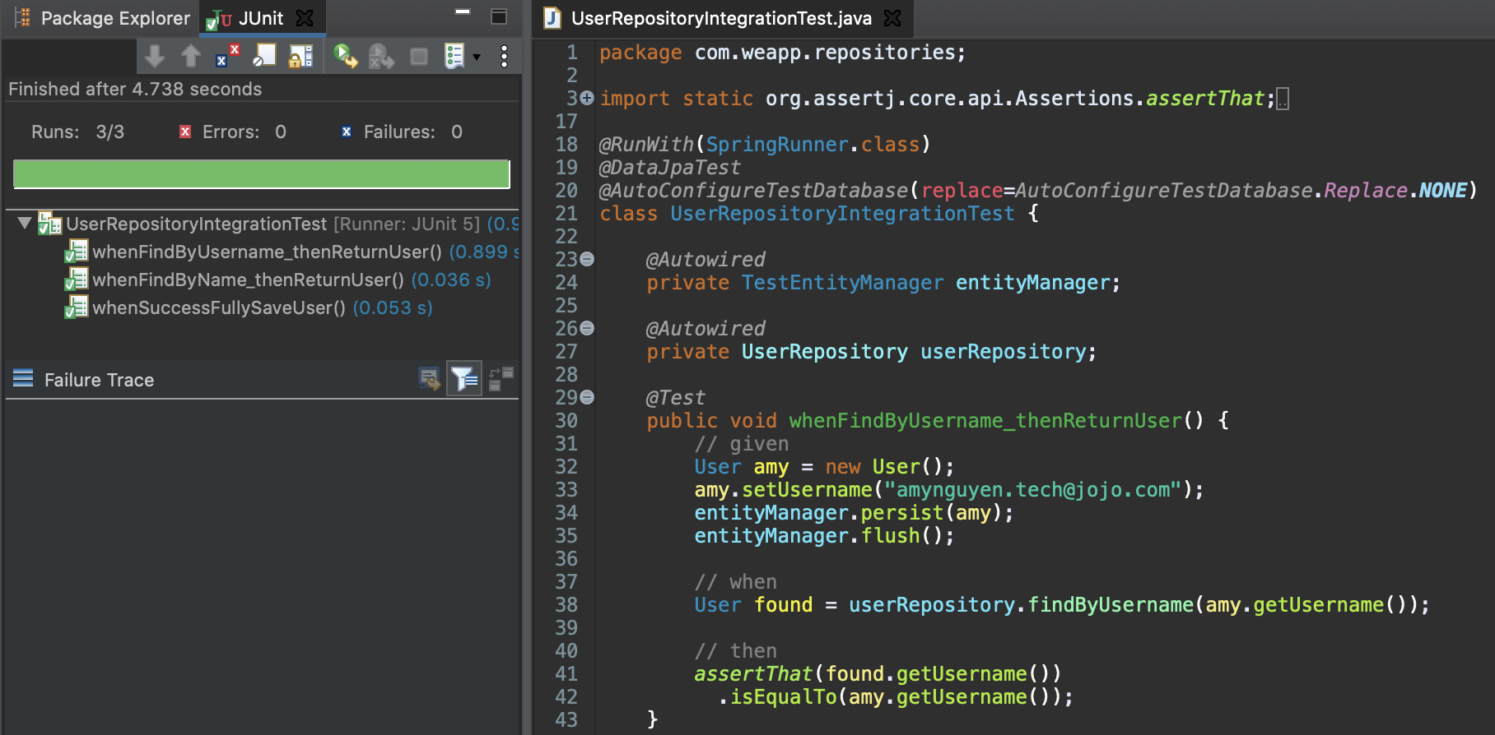
Unit Testing for User Repo
This is the unit test for our User class.
whenFindByUsername_thenReturnUser
whenFindByName_thenReturnUsers
whenSuccessfullySaveUser

Slide 20
Observations
Some interesting bugs that I find
Sort page by name but nothing comes up
Fix by changing the findByName method to not be case sensitive
Dynamic login/logout button for users/unregistered users
Testing is useful and quite difficult at the same time
First mistake: start off high with meticulous test
Break feature into smaller tasks if it gets too big → debugging more manageable

Slide 21
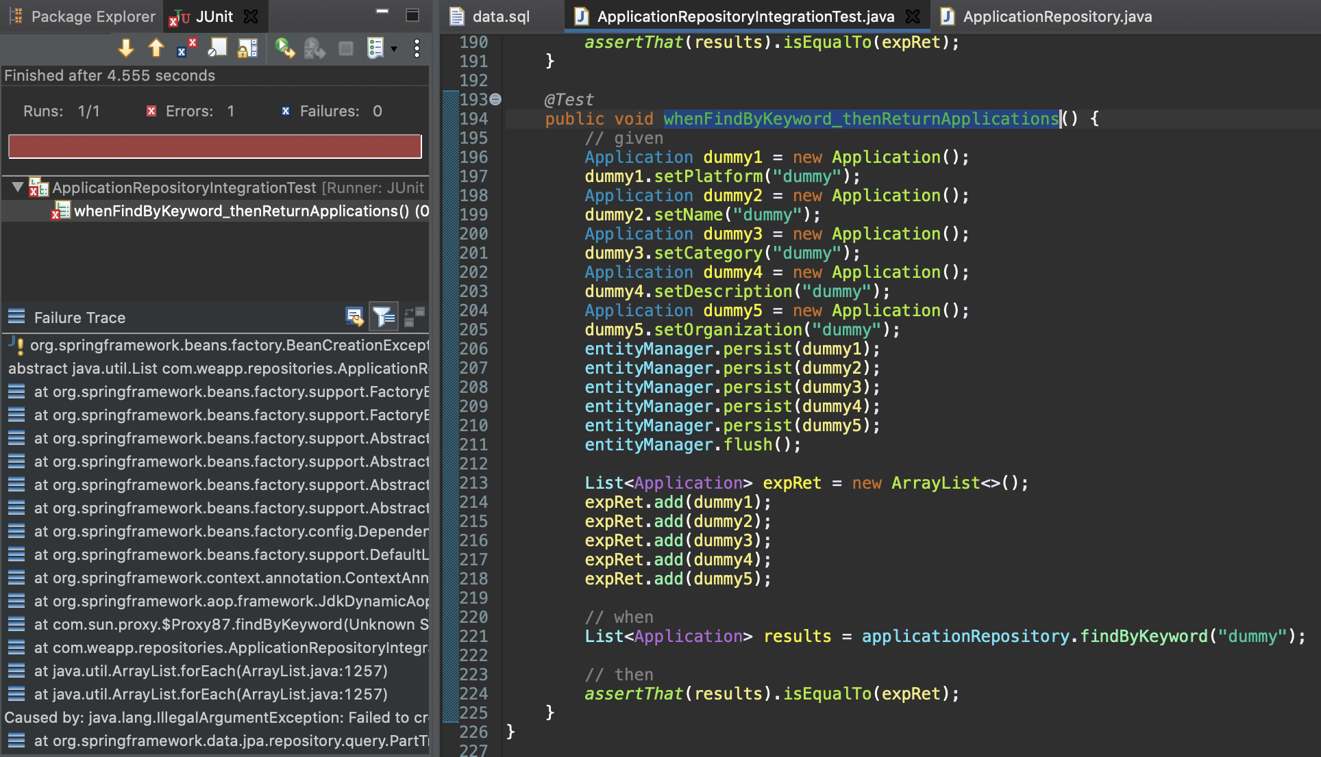
Plan for TDD Approach
A method to test out
whenFindbyKeyword_returnApplication
When user enter a keyword in the search, it will not only return applications with the same name but conduct a search on other attributes like organization, description, category, and platform
Use other test tools for Spring Boot Projects
Write test → Implement (brute force) → Refactor (elegant code)
Next unit tests:
+ Service layer (application service layer) and Controller layer (presentation layer)

Slide 22
4. Build Script & Version Control
Presenter: Jiahao Zhang

Slide 23
Plan for Build Script
We build our Spring Project with Apache Maven to make the build process easier
Maven builds our project using project object model (POM) file, an XML representation of a Maven project. Key features:
Name: describe name of project
URL: url of project
Packaging: details the packaging of our project - in this case a war file
Dependencies: describe the dependencies of the project and contain individual dependency
Scope: describe values like test, runtime, compile
Project: root tag of our project

Slide 24
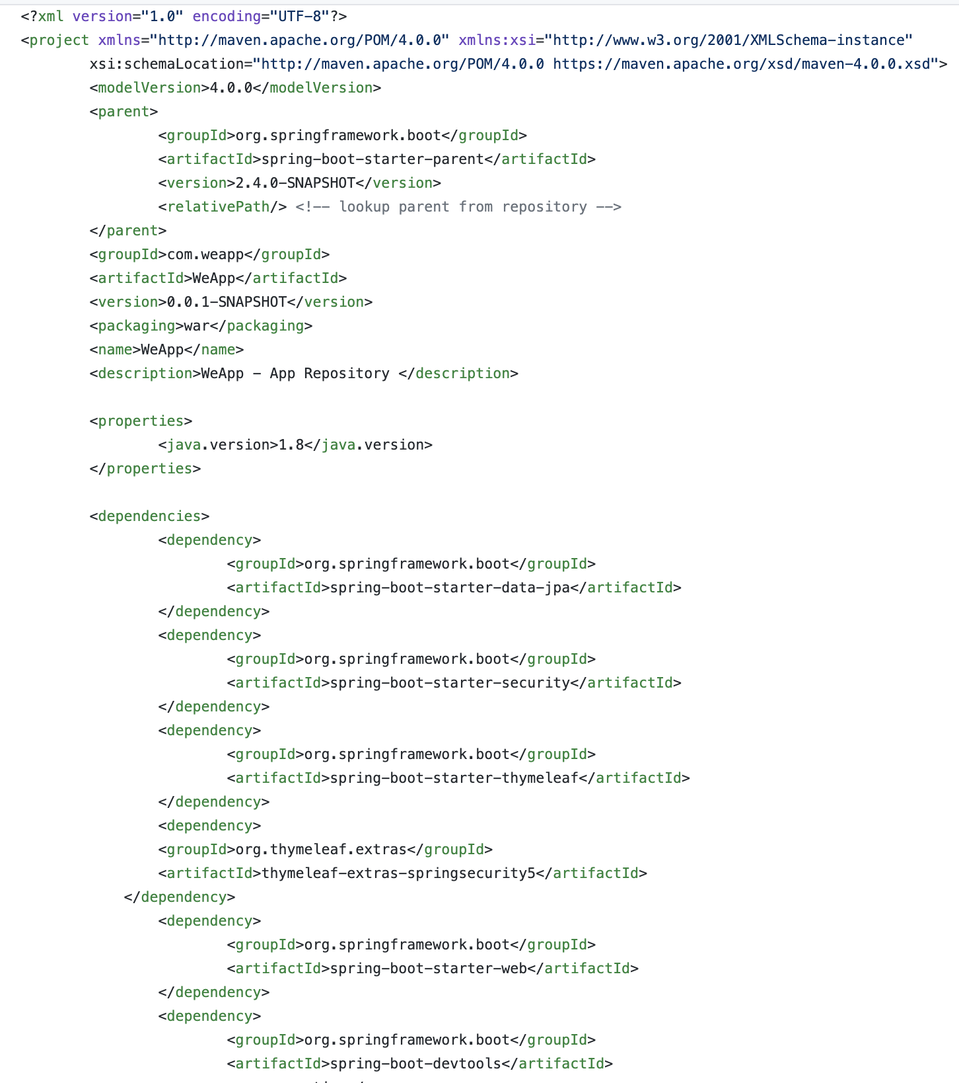
POM.XML
This is a snapshot of our pom.xml file.
Some dependencies for our project include:
Spring Security
Spring Data JPA
Thymeleaf
Embedded H2 Database
(...)

Slide 25
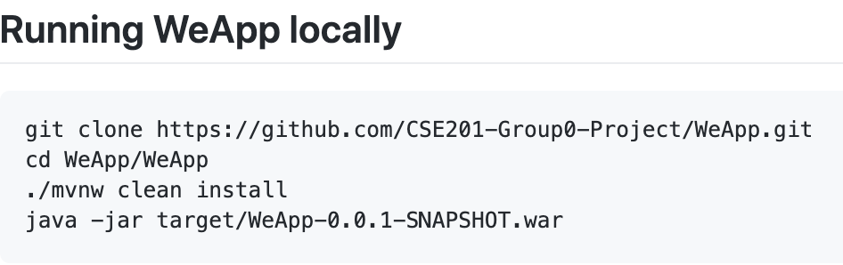
To run our project locally
Maven wrapper to run Maven project
mvnw file is an executable Unix shell script for Linux in place of a fully installed Maven
mvnw.cmd for Windows environment
Directions for users to run project locally. We will turn the following instructions into a shell script to further automate this process for user and include instruction on how to work with this project in Eclipse or other common IDEs

Slide 26
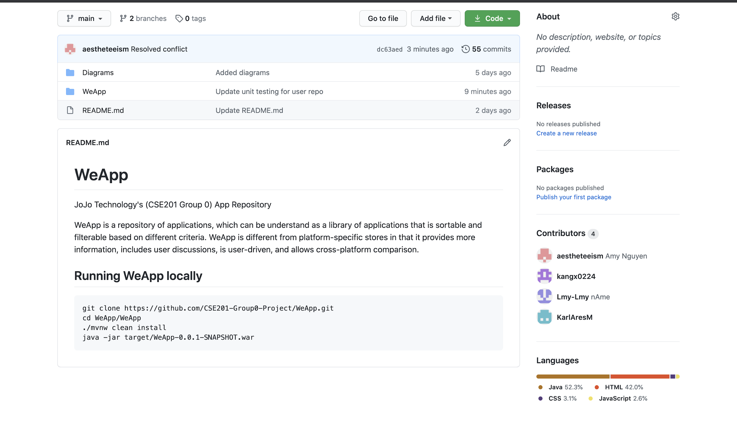
Version Control - Git & Github
We used Git (Distributed Version Control System)
Remote repository on Github
All members contribute
We also keep our documentation here
Screenshot of our Github repo
Main trunk:
Where the main development of our project happen

